Slide 1

Analysis of Women Safety in Indian Cities Using ML on Tweets
by
Rajasri M
Roll No. 214G1A3283
Sreedevi B
Roll No. 214G1A32A2
Keshava Naidu N
Roll No. 214G1A32A6
Premnath Reddy S
Roll No. 214G1A3280
Under the guidance of
G.Ganesh _{M. Tech.}
Assistant Professor
Department of Computer Science and Engineering (Data Science)
Srinivasa Ramanujan Institute of Technology
(Affiliated to JNTUA & Approved by AICTE) (Accredited by NAAC with ‘A’ Grade & Accredited by NBA (EEE, ECE & CSE)
Rotarypuram Village, B K Samudram Mandal, Ananthapuramu – 515701.
2024 - 2025

Slide 2
Contents
Abstract
Problem Statement
Literature Survey
Existing Method
Proposed Method
Block Diagram
Prerequisites for implementation
System Requirements
Architecture
System Design Modules
UML Diagram
Class Diagram
Collaboration Diagram
Deployment Diagram
Component Diagram
Implementation
Activity Diagram
ER Diagram
Reference
Conclusion

Slide 3
Abstract
Women and girls in Indian cities face significant challenges such as stalking, sexual harassment, and assault in public spaces. This research explores the role of social media platforms like Twitter, Facebook, and Instagram in promoting women’s safety and raising awareness. Social media serves as a tool to disseminate messages, quotes, and stories, educating the youth and encouraging strict action against offenders. Women often use platforms like Twitter to express their feelings about safety while commuting or working, sharing their experiences through hashtags that reach a global audience.

Slide 4
Contd..
To analyze these sentiments, this study employs machine learning algorithms, including Support Vector Machine (SVM), Neural Networks, Gradient Boosting, Random Forest, Decision Tree, Naive Bayes, and K-Nearest Neighbors (KNN). These models classify tweets into positive, negative, or neutral sentiments while assessing their performance using metrics like accuracy, precision, and recall.
This research highlights how technology and societal responsibility can promote women's safety. By leveraging machine learning and social media, it emphasizes the need for collective action to create safer environments for women.
Keywords: Women’s safety, social media, Twitter, machine learning, SVM, Neural Networks, Gradient Boosting, Random Forest, Decision Tree, Naive Bayes, KNN, sentiment analysis.

Slide 5
Problem Statement
Twitter has emerged as the ultimate microblogging social network in the modern era, with over 100 million users and over 500 million 'Tweets' sent every day. With such a large audience, Twitter has attracted users to share their opinions and judgments on every existing issue and topic on the internet; as a result, Twitter is an informative source for all sectors such as institutions, businesses, and organizations.
In the tweets section of Twitter, users will share their thoughts and opinions. Because this tweet has a character limit of 140 characters, users must condense their messages using abbreviations, slang, shot forms, emoticons, and other techniques. In addition, many people use polysemy and sarcasm to express themselves. As a result, Twitter language is classified as unstructured. The sentiment underlying the message is derived from the tweet. The sentimental analysis procedure is used to extract this data.
The sentiment analysis results can be used in a variety of contexts, such as analysing public opinion on government policies, people's attitudes toward women, and so on. A great deal of research has been done on the data obtained by twitter in order to perform tweet classification and analyse the results

Slide 6
Contd..
In this paper, we also review some machine learning studies as well as research on how to perform sentiment analysis on Twitter data using that domain. The focus of the paper is on machine learning algorithms and models.
Staring at women and making comments can be considered forms of violence and harassment, and these practises, while unacceptable, are common, particularly in urban areas. Many studies conducted in India show that women have reported sexual harassment and other practises such as those mentioned above. Such studies have also revealed that in popular metropolitan cities such as Delhi, Pune, Chennai, and Mumbai, most women feel unsafe when they are surrounded by strangers. People can freely express themselves on social media about Indian politics, society, and a variety of other topics. Similarly, women can share their experiences if they have faced violence or sexual harassment, bringing innocent people together to fight back on these occurrences According to the analysis of tweets text collection obtained by Twitter, it includes names of people who have harassed women, as well as names of women or innocent people who have stood up to such violent acts or unethical behaviour by men, making them feel uncomfortable walking freely in public.

Slide 7
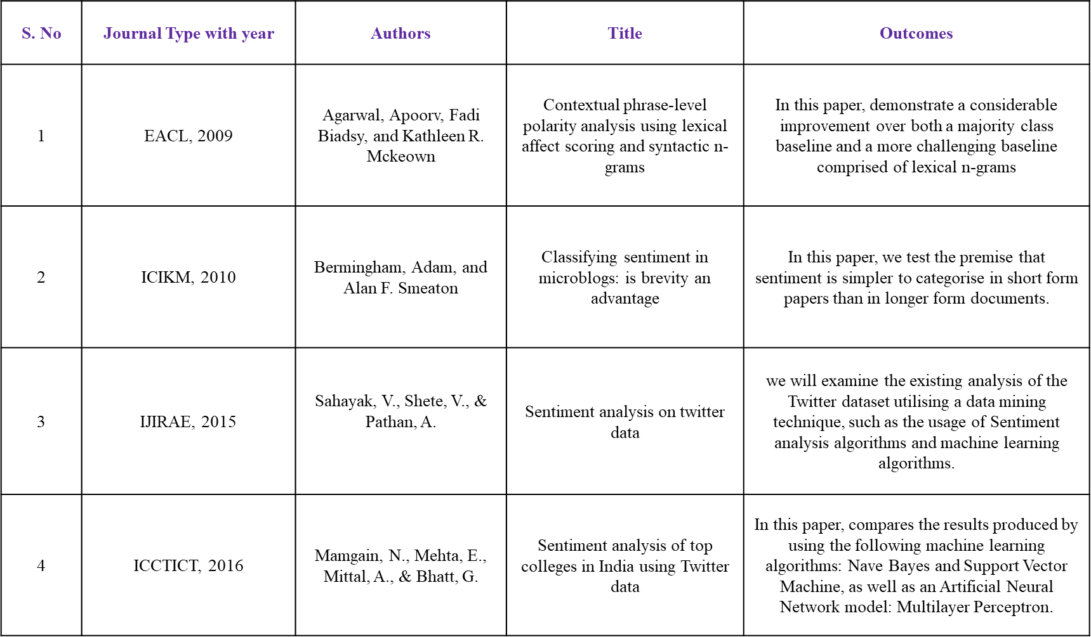
Literature survey

Slide 8
EXISTING METHOD
When we consider these systems were previously, they used to find the records manually which leads to waste they no fast response in the case and they need to search each and everything were as in previous system they don’t have the awareness about the technology due to that many women lost their life valuable life so to reduce the crime against the women we are implementing different system.
Disadvantages:
More time
It’s difficult to find them
Less efficiency

Slide 9
Proposed Method
When we consider now due rapid change in the society. The people have more awareness against such kinds of crimes. Now they need to maintain the records manually everything can be maintained and we can find out the criminal easily by using these we can find his enter details of him and we can punish him. And we can also find the previous records. Here we are implementing using the ML based algorithms are Ada boosting, Cat boosting, SVM and Naïve Bayes. These algorithms are used for training the dataset from which we can predict the output.
Advantages:
Less time
More accurate result
More efficiency

Slide 10
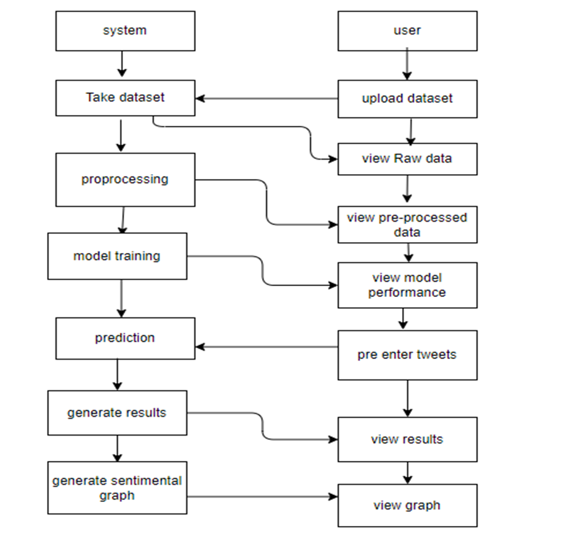
BLOCK DIAGRAM

Slide 11
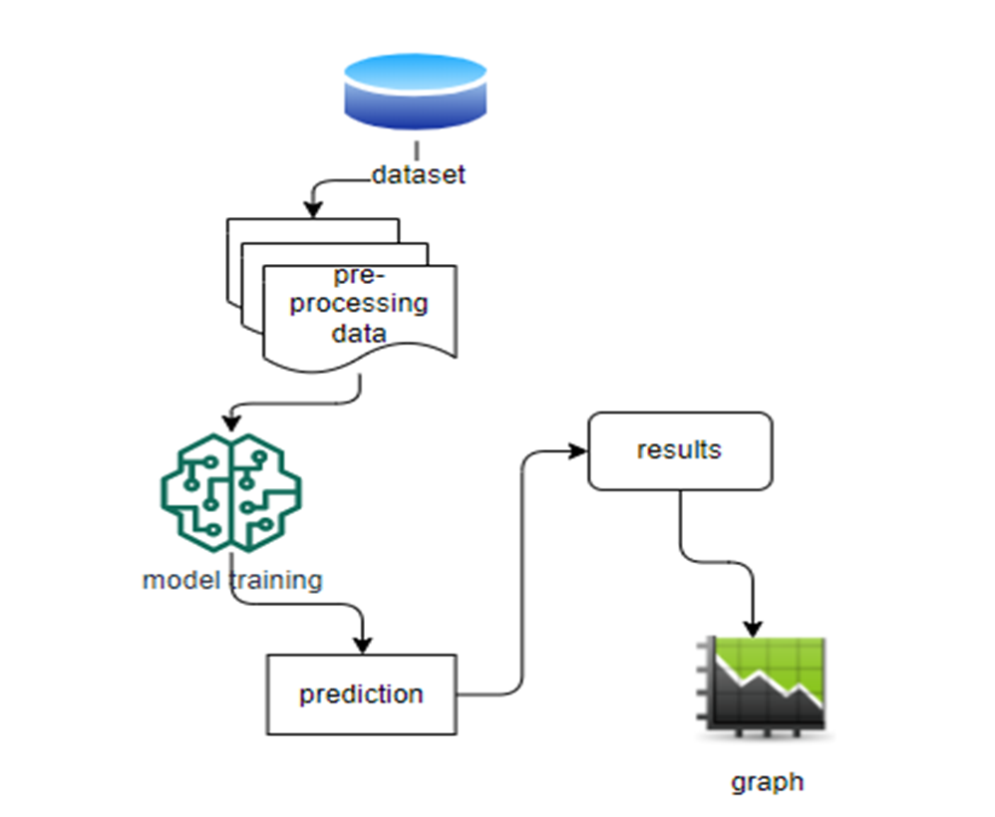
ARCHITECTURE

Slide 12
System Design Modules
SYSTEM
1. Upload Dataset:
This module is concerned with uploading the csv file on the Project where the dataset is a twitter csv file that contains tweet id , date of creation, text, url , latitude , longitude, followers, following and other relevant information.
2. Data Pre-processing:
This Module is meant for removing unnecessary features or columns that has maximum null values. Since most of them are null values, they doesn't convey any information or has impact on the output target variable. This module is also connected with consolidating the values as per the tweet id like no of tweets, age, no of followers, no of following, retweets, favourites and plenty other information.

Slide 13
Contd…
3. Bag of words Module:
In this model we are going to create models Bag of words for each class separately. Here the classes are POSITIVE, NEUTRAL and NEGATIVE. Here NEGATIVE stands for a junk tweet and POSITIVE stands for a legitimate Tweet. From this BOW we are going to generate top 10 words from each class so as to know the most frequent words in the Tweets.
4. Training the Model:
This Module is meant for creating a Model (s) as per the problem statement. Before this creation we are going to split the given data into two parts: Train and Test. Here train data is used for fitting or training the module.

Slide 14
Contd…
USER
5. Validating the Model:
Using Test data obtained from previous module we are going to test or validate the model for accuracy. Classification report is another measure which consolidates all the above metrics.
6. Tables/ Graphs:
This module is concerned with generating the reports or graphs or tables as per the results obtained from training and testing the model.

Slide 15
UML Diagrams
Uml stands for unified modeling language. Uml is a standardized general-purpose modeling language in the field of object-oriented software engineering. The standard is managed, and was created by, the object management group.
The goal is for uml to become a common language for creating models of object oriented computer software. In its current form uml is comprised of two major components: a meta-model and a notation. In the future, some form of method or process may also be added to; or associated with, uml.
The unified modeling language is a standard language for specifying, visualization, constructing and documenting the artifacts of software system, as well as for business modeling and other non-software systems.
The uml represents a collection of best engineering practices that have proven successful in the modeling of large and complex systems.

Slide 16
Contd..
The uml is a very important part of developing objects oriented software and the software development process. The uml uses mostly graphical notations to express the design of software projects.
Use case diagram:
A use case diagram in the unified modeling language (uml) is a type of behavioral diagram defined by and created from a use-case analysis. Its purpose is to present a graphical overview of the functionality provided by a system in terms of actors, their goals (represented as use cases), and any dependencies between those use cases. The main purpose of a use case diagram is to show what system functions are performed for which actor. Roles of the actors in the system can be depicted.

Slide 17
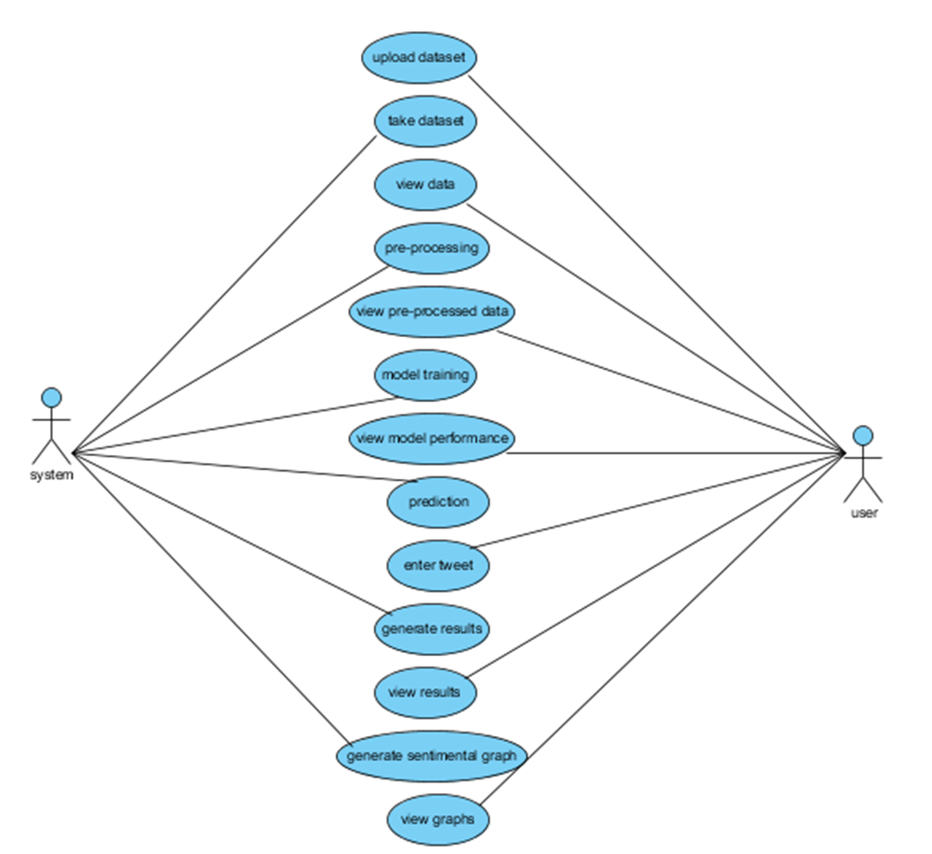
Contd….

Slide 18
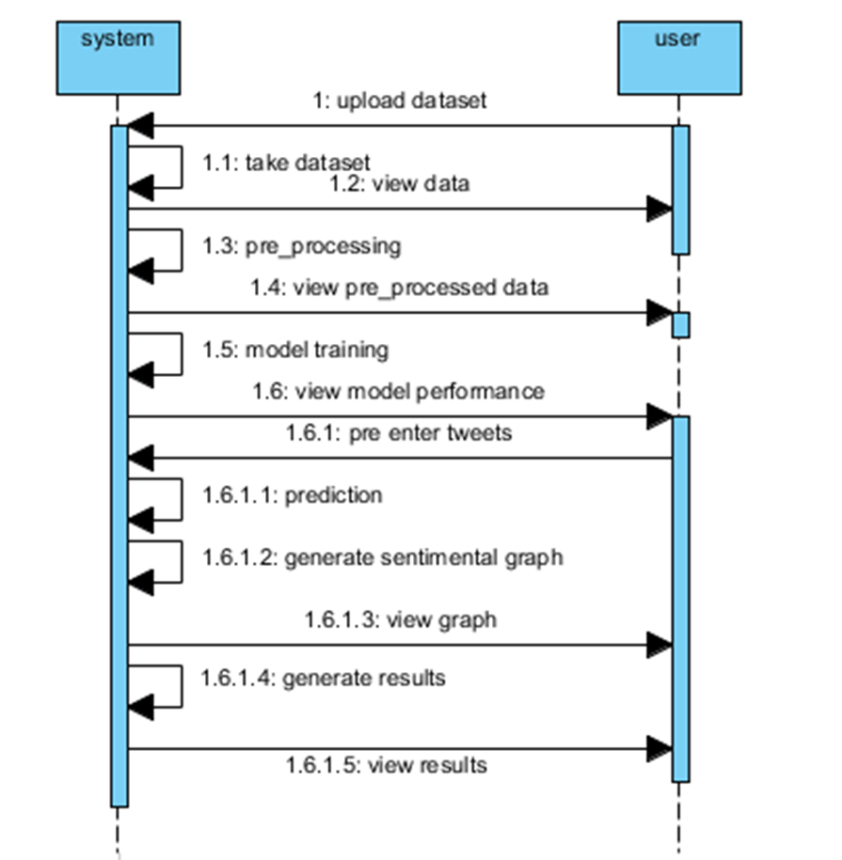
Contd…

Slide 19
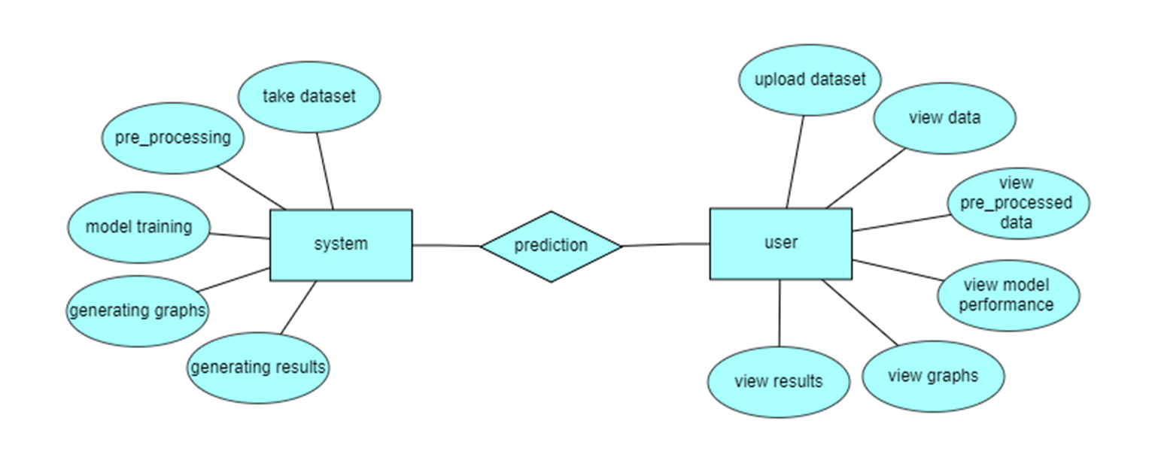
ER Diagram:
An Entity–relationship model (ER model) describes the structure of a database with the help of a diagram, which is known as Entity Relationship Diagram (ER Diagram). An ER model is a design or blueprint of a database that can later be implemented as a database. The main components of E-R model are: entity set and relationship set.

Slide 20
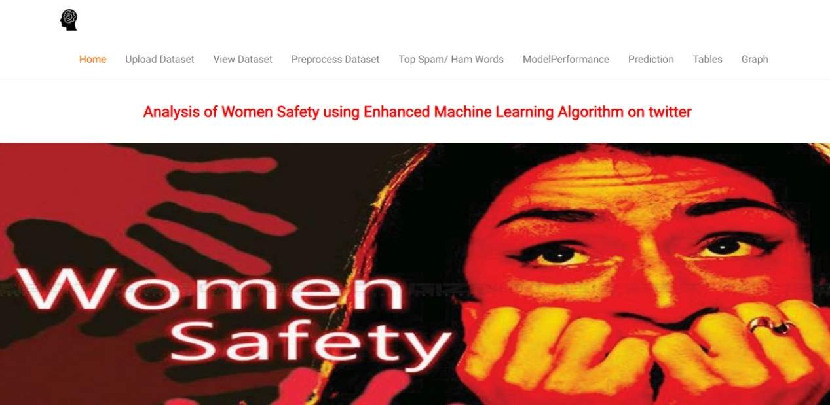
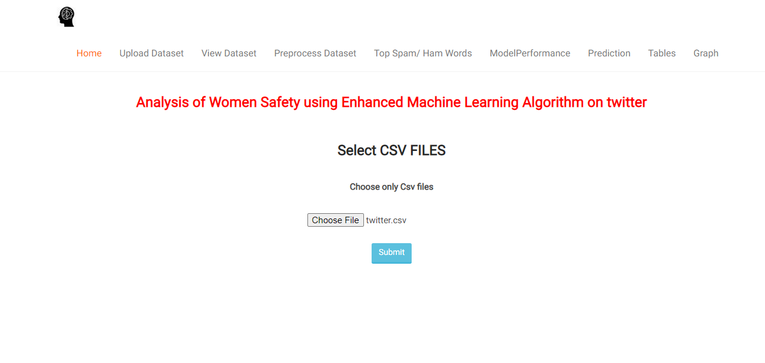
Implementation

Slide 21
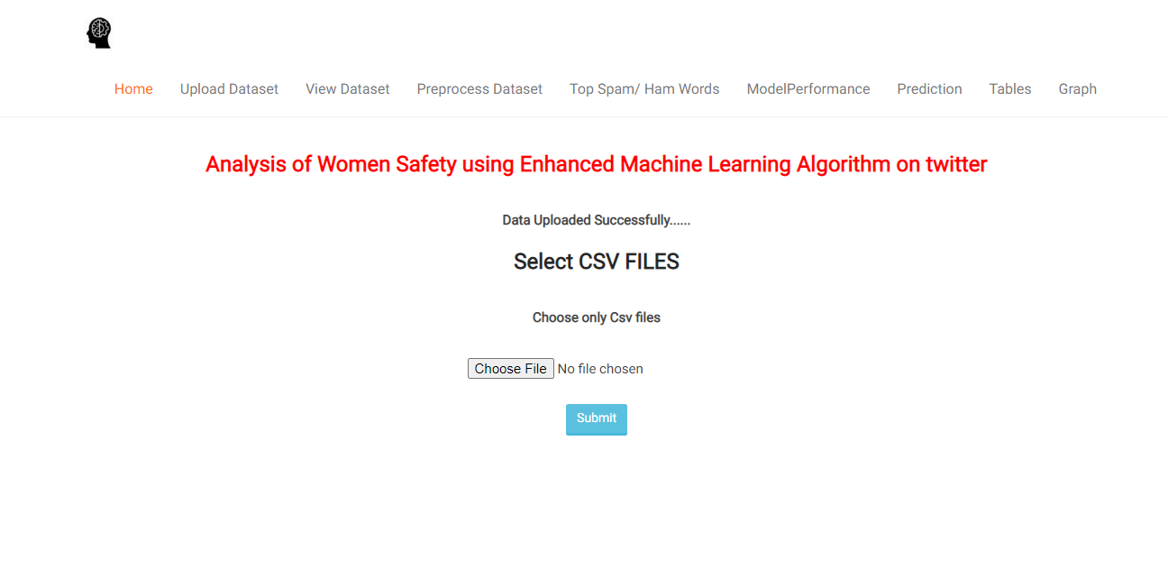
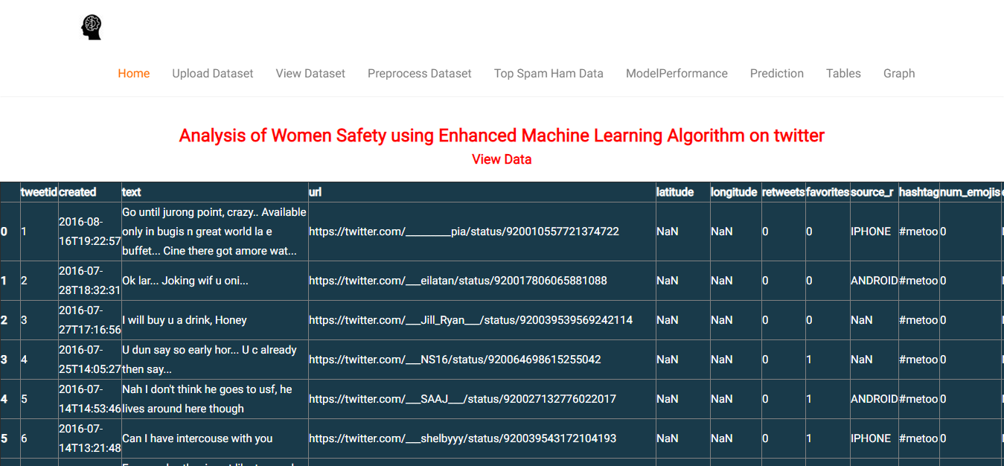
Contd..

Slide 22
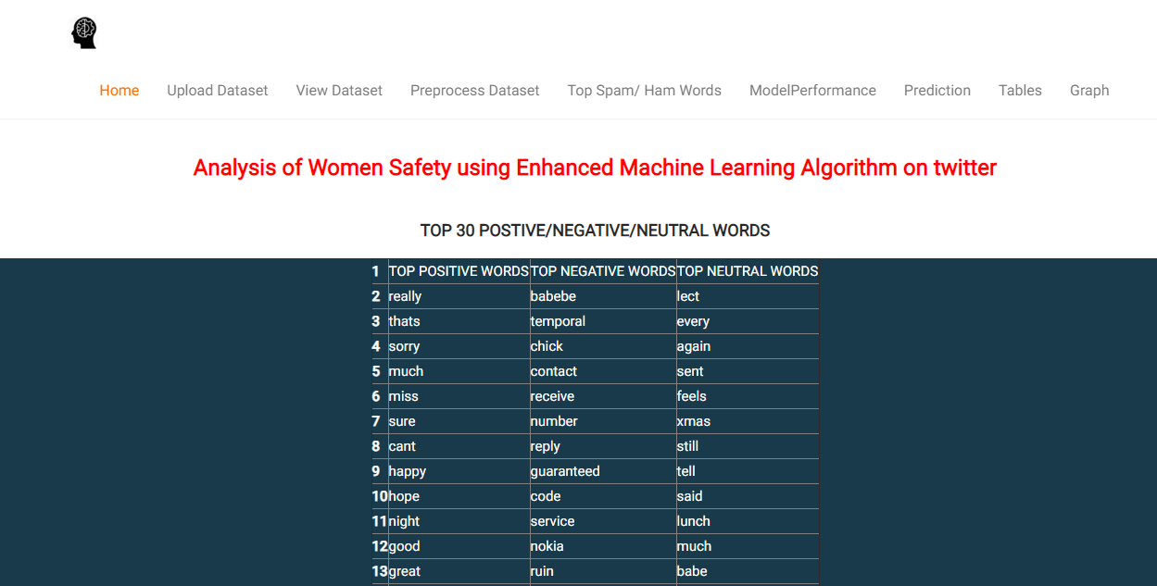
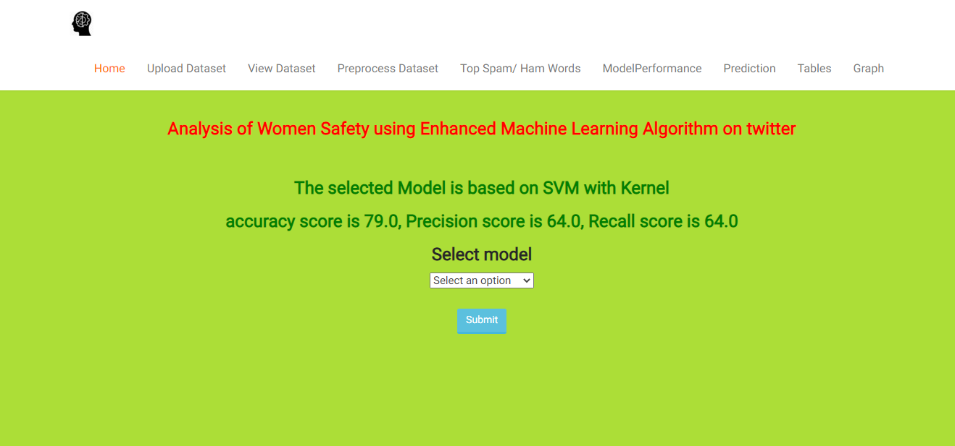
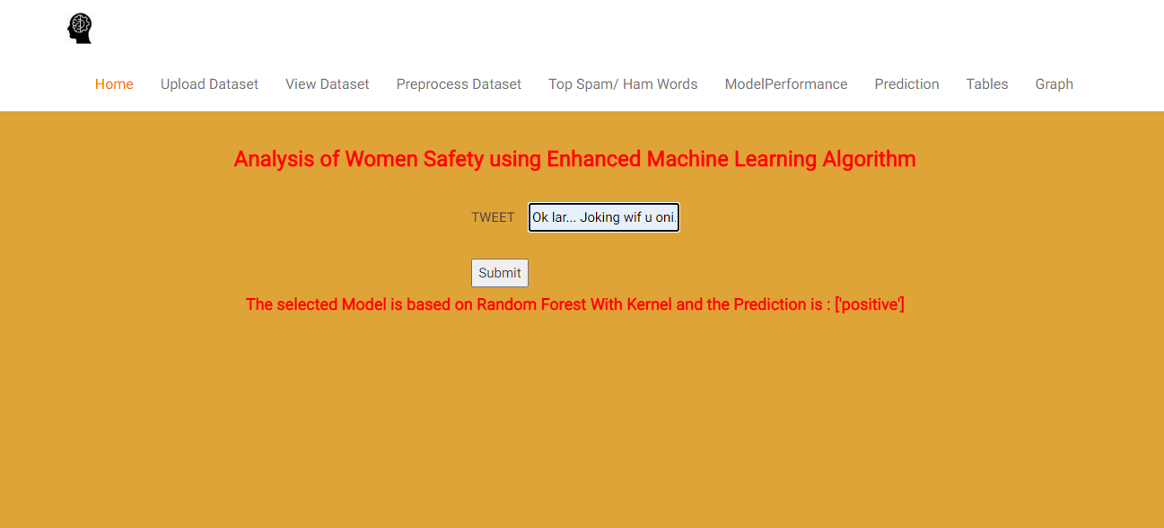
Contd..

Slide 23
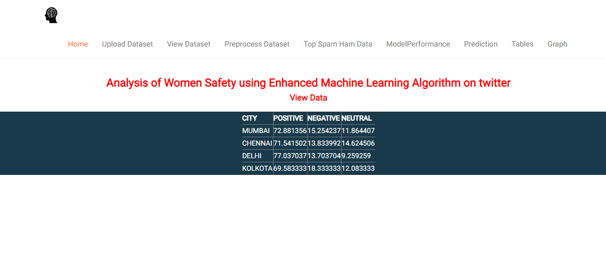
Contd..

Slide 24
Conclusion
Women and girls have been subjected to a great deal of violence and harassment in public areas around the country, ranging from stalking to sexual harassment and assault. This application also focuses on how common Indian people can establish a sense of responsibility on the part of Indian society, so that we can focus on the safety of women in their environment. By using Tweets about the safety of women in India, which frequently include images and text as well as written comments and phrases, we can predict the sentiment of the tweet and use it to analyze the type of tweet. Therefore by interpreting the results we can improve the safety of women.

Slide 25
Any Queries?

Slide 26
Thank You!!!

